Slide 1
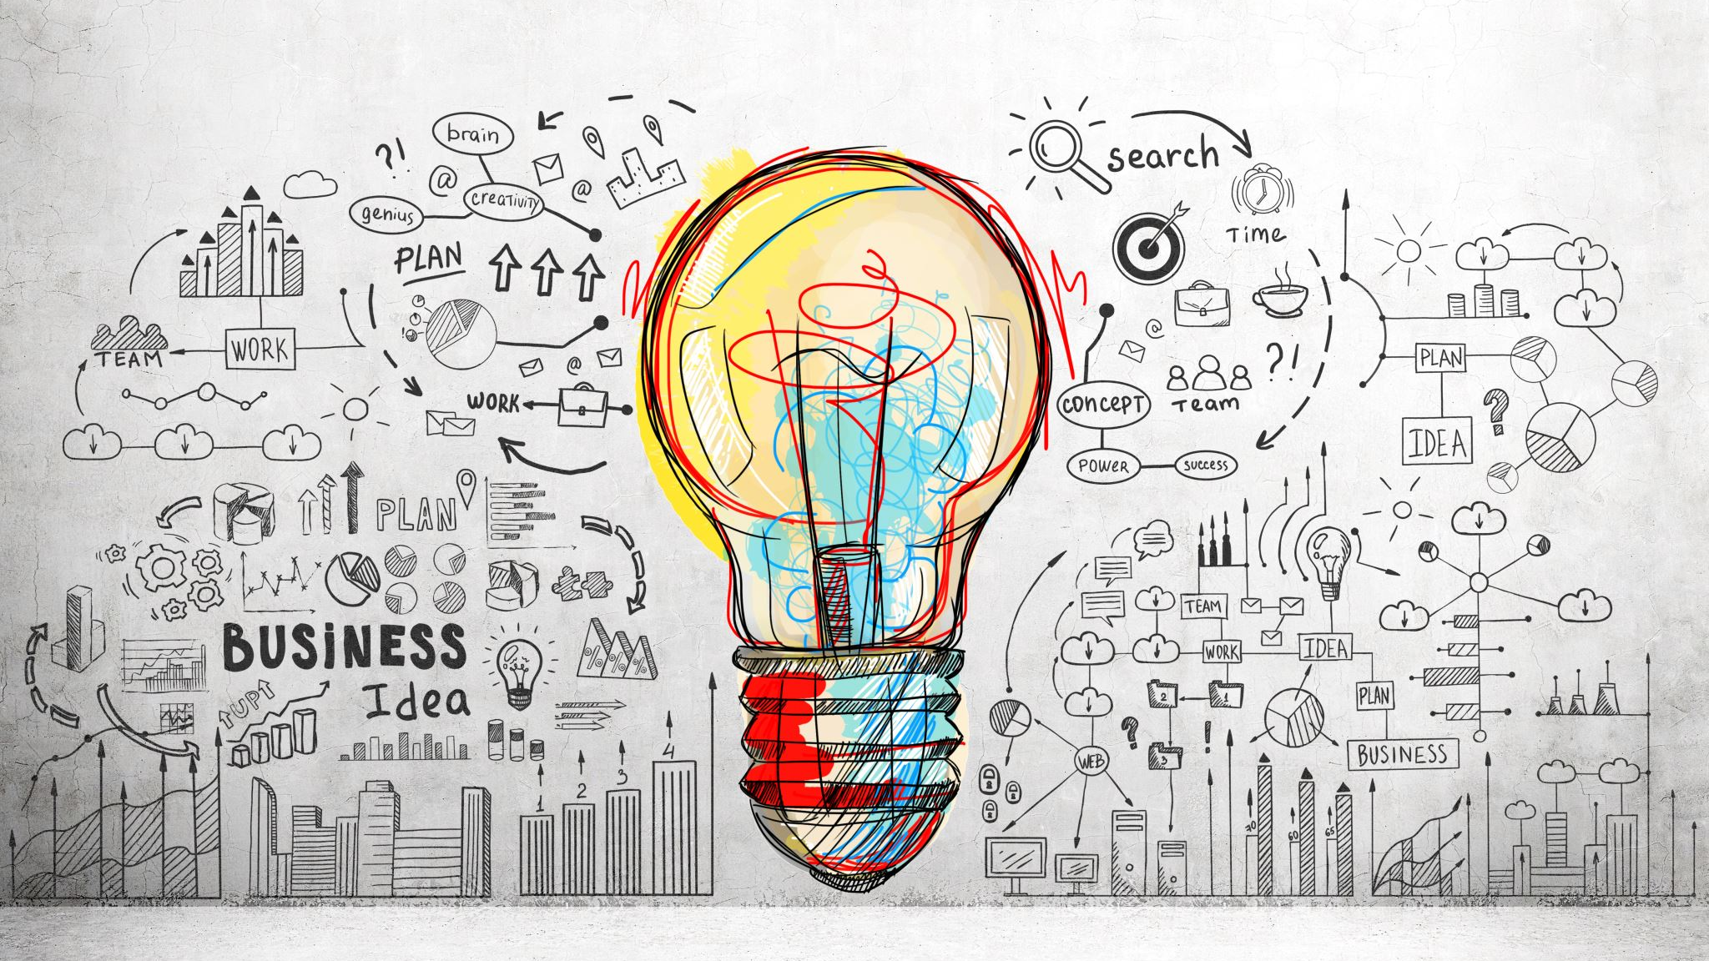
Model Monitoring
Data science lifecycle
Notes:
Tonight I am going to discuss a part of the model lifecycle called model monitoring. We have started to discuss what models are and what goes into making them. So what happens after exploratory data analysis, feature selection, model training and model evaluation is done? Is a data scientists job finished? I don’t have any first hand experience but I was curious to find out. Model monitoring is an aspect of data science solely concerned with a model after it goes to a production environment. They are techniques used to ensure that what started as a good model continues to do so.

Slide 2
Model Drift
Concept Drift – change in dependent variable
Covariate Drift - change in features
Notes:
Model drift is the primary issue that dictates the need for good model monitoring.
Model drift has two main types – concept drift and covariate drift.
Concept drift occurs when you have a fundamental change in the distribution of the target variable you are modeling. Therefore, old statistical relationships between dependent and independent variables are no longer the same.
A good example of this drift would be the changes in consumer spending once the covid pandemic hit. The underlying target variable changed fundamentally and now any old models are no longer going to accurately predict consumer behavior. Covariate drift refers to the change in the data of one or more of the features used to build the model. This could happen when you lose access to one of your data streams. The relationship hasn’t fundamentally changed but your ability to make accurate predictions may have.

Slide 3
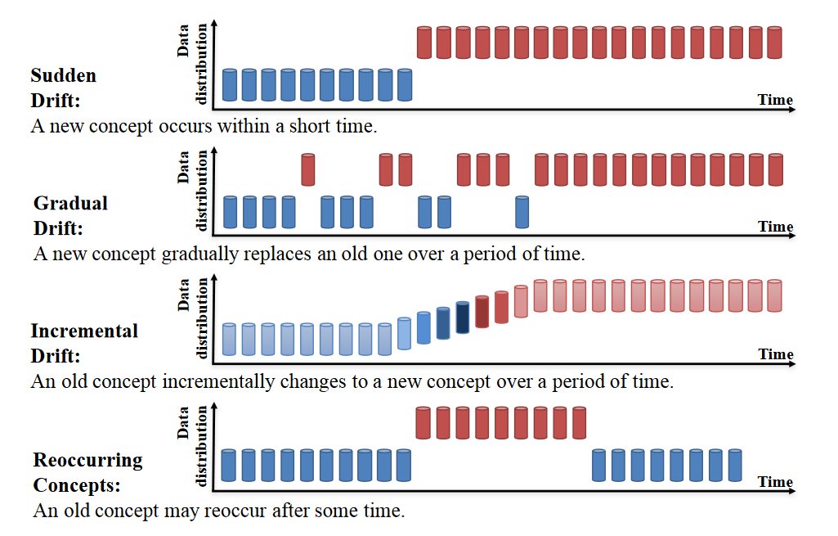
https://arxiv.org/pdf/2004.05785.pdf
Notes:
As you can see here in this graphic, drift can occur according to different timelines. Some happen suddenly, while others follow slower different trajectories. The ramifications for not maintaining good monitoring practices will vary depending on why the drift occurred. In the Covid consumer spending model example, there could have been a sudden shift in the accuracy of the model which may have had serious business implications. However, not all drifts are necessarily worse for models. Sometimes your model gets lucky and could accidentally improve.

Slide 4
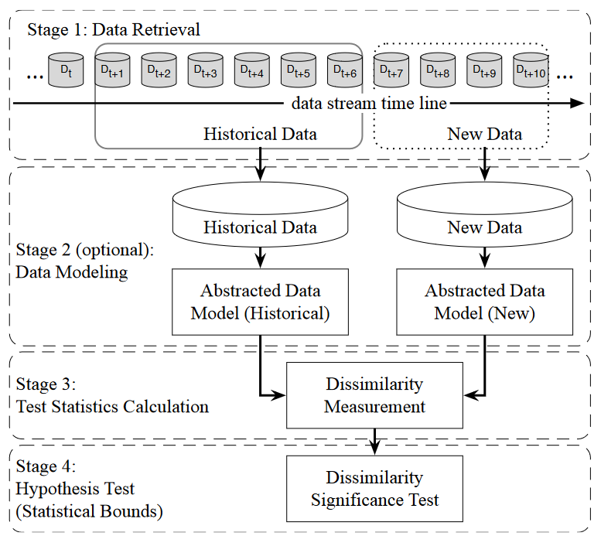
Drift Detection
https://arxiv.org/pdf/2004.05785.pdf
Notes:
The data science solution to drift is conveniently a group of statistical methods. The details will vary depending on the types of variables but will fundamentally be hypothesis testing. Is the training data and the model output statistically the same with the historical data compared to new data.

Slide 5
Model Updating Methods
Blind Updates – periodic retraining
Incremental learning – continuous retraining
Weighting Data – training weight assigned to newer data
Notes:
Once a drift has occurred and been detected, model retraining is needed to correct the drift. There are a few different approaches to model retraining and will often depend on domain specifics. Blind updates are regularly scheduled model training incorporating new data. Incremental learning is similar but new data is incorporated continuously as it becomes available. The last method using weighted data has a different approach. Whenever the model is retrained it will assign more weight the newer the data is to more accurately capture drift.

Slide 6
Additional Resources AWS Sagemaker Model Monitor Tensor Flow Data Validation
Notes:
That concludes my presentation. Here are some additional references for enterprise production solutions using Tensorflow and AWS

